Slide 1
運用優先權與無耐性之區塊鏈交易模型研究 A Study on Blockchain Transaction Models with Priority and Impatience
指导教授： 钟顺平 教授
研 究 生： 蔡怡翔
公元 2025 年 0 月 0 日

Slide 2
Outline
Motivation
System Model
Analytical Model
Numerical Results
Conclusions and Future Works

Slide 3
Outline
Motivation
System Model
Analytical Model
Numerical Results
Conclusions and Future Works

Slide 4
Motivation
Blockchain is a foundational infrastructure for digital trust and decentralized system
Decentralization, transparency, and immutability
Bit coin, finance healthcare media logistics energy
Interoperability → Cross-chain bridges
Notes:
區塊鏈目前已迅速發展成為數位信任與去中心化系統的基礎架構。
有著去中心化、透明性與不可篡改性等特性，適用於資料的安全儲存。
區塊鏈原先設計用於支持比特幣等加密貨幣，但如今已廣泛應用於金融、醫療、媒體、物流與能源等多個領域。
然而，當今區塊鏈技術面臨的一項重大挑戰是「跨鏈互通性」，也就是讓獨立運作的區塊鏈網路之間能夠互相溝通與交換資產或資訊。
為解決此問題，開發出了「跨鏈橋接（cross-chain bridges）」

Slide 5
Motivation
In [2], apply M/M/n/L queues modeling transaction processing and block generation in Bitcoin
Queue length / block generation rate
In [7], Blockchain queuing model with non-preemptive limited-priority is proposed.
In [10], Queueing model for cross-chain transaction flows is presented.

Slide 6
Motivation
Two sequential queues: customer queue and block queue
Customer queue: waiting to be selected for block formation
Block queue: undergoing consensus
ON / OFF mechanism
Partial batch service
Capture realistic life
Non-preemptive priority
Impatience

Slide 7
Outline
Motivation
System Model
Analytical Model
Numerical Results
Conclusions and Future Works

Slide 8
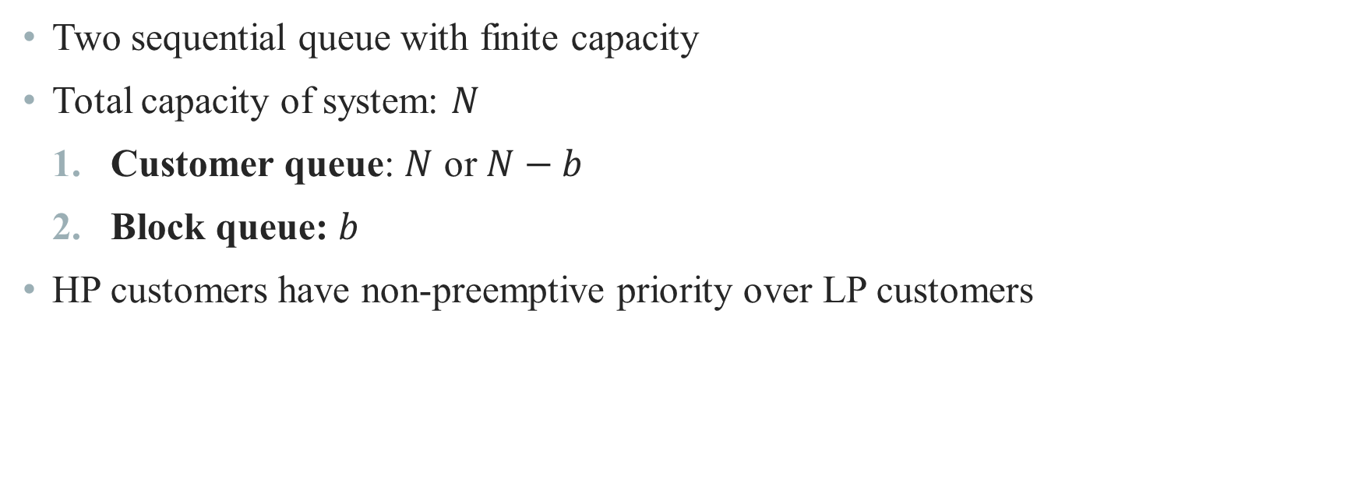
System Model
Two sequential queue with finite capacity
Total capacity of system: $N$
Customer queue: $N$ or $N−b$
Block queue: $b$
HP customers have non-preemptive priority over LP customers

Slide 9
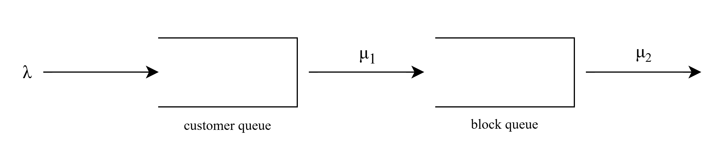



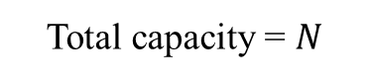
System Model
Total capacity = $N$
$$N$$
num in block queue = 0
$$N−b$$
$$0\sim b$$
num in block queue > 0
9

Slide 10
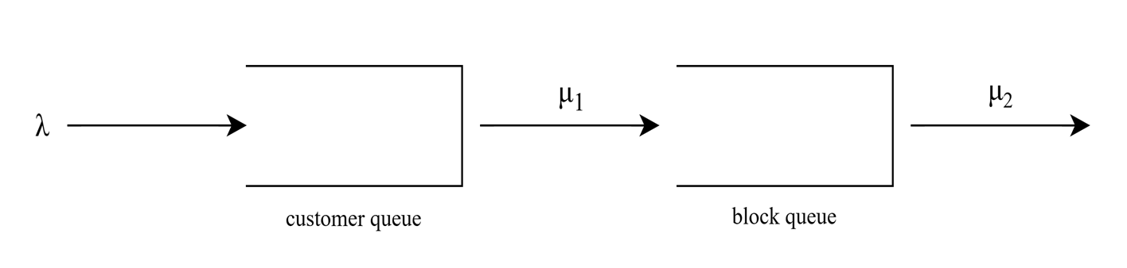
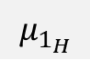
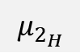
System Model – Scenario 1
2
1
$$μ_{1_{H}}$$
block
$$μ_{2_{H}}$$

Slide 11

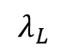
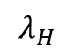
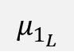
System Model – Scenario 2
$$λ_{H}$$
(Non-preemptive)
L
H
$$μ_{1_{H}}$$
LP block
L
$$μ_{1_{L}}$$
$$λ_{L}$$

Slide 12
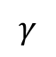
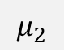
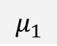
System Model – Scenario 3
2
1
$$μ_{1}$$
block
$$μ_{2}$$
$$γ$$

Slide 13
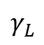
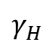
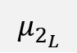
System Model – Scenario 4
$$λ_{H}$$
(Non-preemptive)
L
H
$$μ_{1_{H}}$$
LP block
$$μ_{2_{H}}$$
L
$$μ_{1_{L}}$$
$$μ_{2_{L}}$$
$$λ_{L}$$
$$γ_{L}$$
$$γ_{H}$$

Slide 14
Outline
Motivation
System Model
Analytical Model
Numerical Results
Conclusions and Future Works

Slide 15
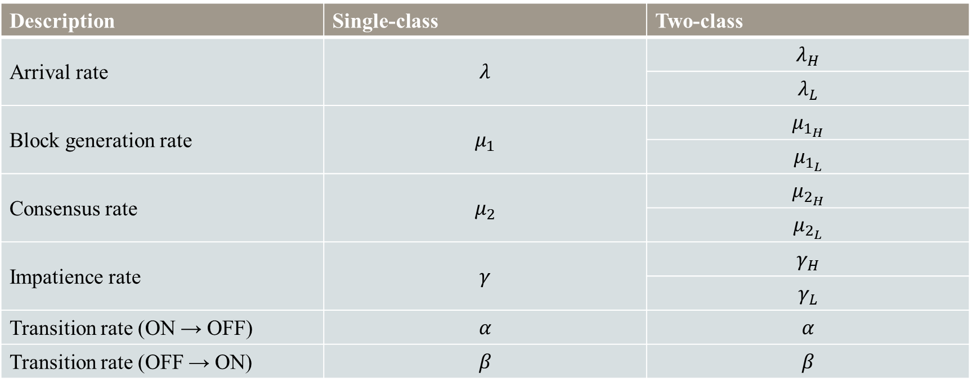
Analytical Model
Description | Single-class | Two-class
Arrival rate | $$λ$$ | $$λ_{H}$$
 |  | $$λ_{L}$$
Block generation rate | $$μ_{1}$$ | $$μ_{1_{H}}$$
 |  | $$μ_{1_{L}}$$
Consensus rate | $$μ_{2}$$ | $$μ_{2_{H}}$$
 |  | $$μ_{2_{L}}$$
Impatience rate | $$γ$$ | $$γ_{H}$$
 |  | $$γ_{L}$$
Transition rate (ON → OFF) | $$α$$ | $$α$$
Transition rate (OFF → ON) | $$β$$ | $$β$$

Slide 16
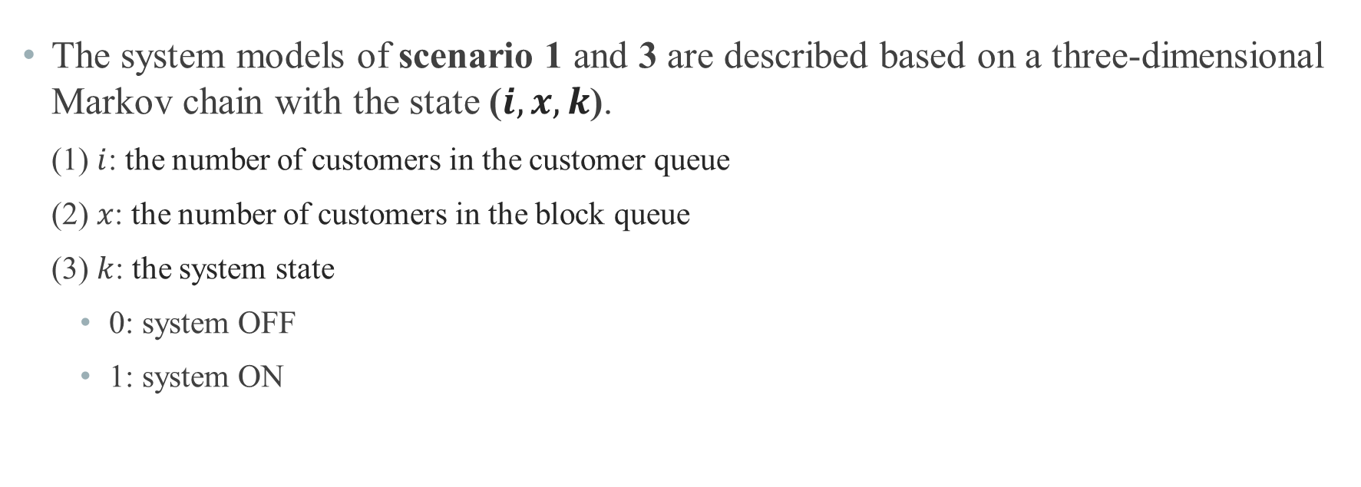
Analytical Model
The system models of scenario 1 and 3 are described based on a three-dimensional Markov chain with the state ($i, x, k$).
(1) $i$: the number of customers in the customer queue
(2) $x$: the number of customers in the block queue
(3) $k$: the system state
0: system OFF
1: system ON

Slide 17
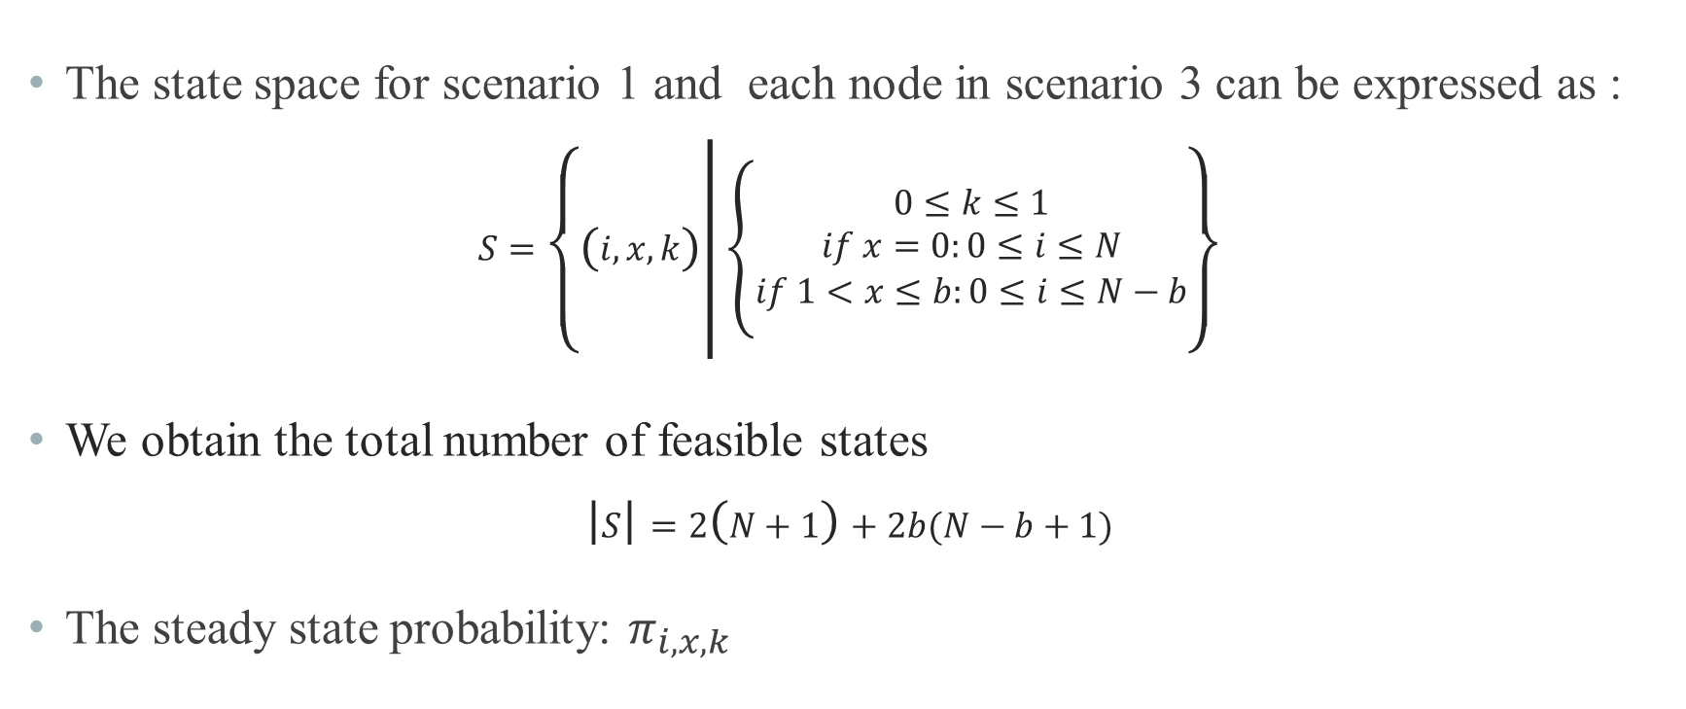
Analytical Model
The state space for scenario 1 and each node in scenario 3 can be expressed as :
$$S=\left\{\left(i, x, k\right) | \left\{\begin{aligned}0≤k≤1 \\ if x=0:0≤i≤N \\ if 1<x≤b:0≤i≤N−b\end{aligned}\right.\right\}$$
We obtain the total number of feasible states
$$\left|S\right|=2\left(N+1\right)+2b(N−b+1)$$
The steady state probability: $π_{i,x,k}$

Slide 18
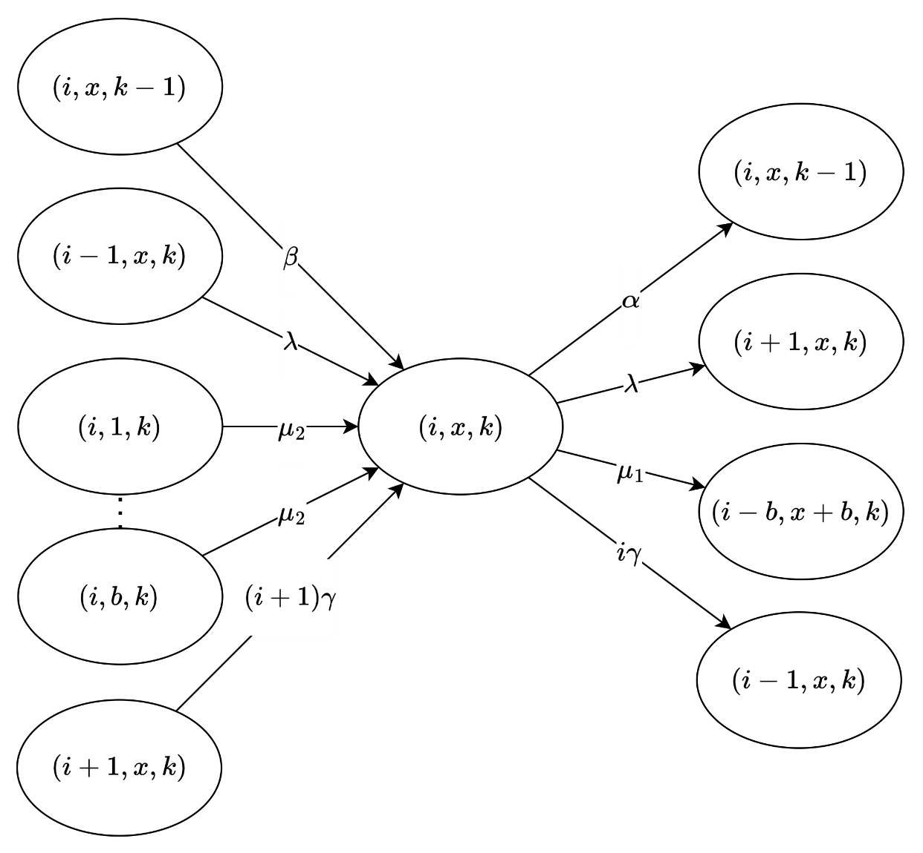
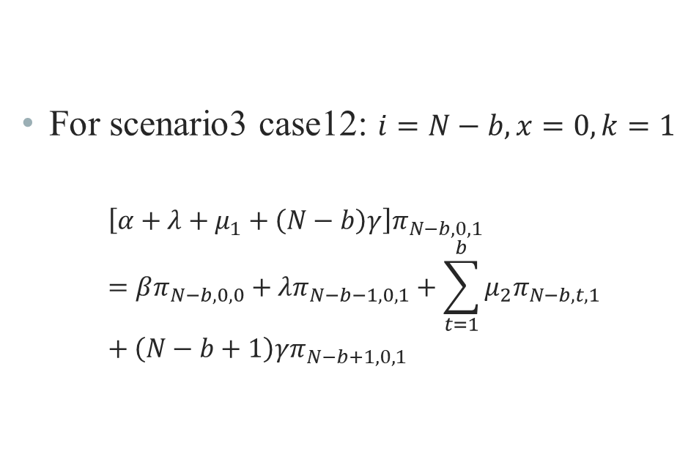
Analytical Model – State Balance Equations
For scenario3 case12: $i=N−b, x=0, k=1$
$$\left[α+λ+μ_{1}+\left(N−b\right)γ\right]π_{N−b,0,1}=βπ_{N−b,0,0}+λπ_{N−b−1,0,1}+\sum_{t=1}^{b}{μ_{2}π_{N−b,t,1}}+\left(N−b+1\right)γπ_{N−b+1,0,1}$$

Slide 19
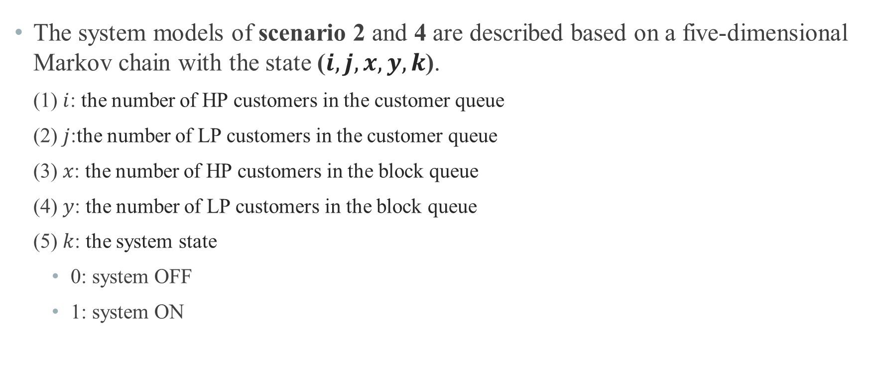
Analytical Model
The system models of scenario 2 and 4 are described based on a five-dimensional Markov chain with the state ($i,j,x, y,k$).
(1) $i$: the number of HP customers in the customer queue
(2) $j$:the number of LP customers in the customer queue
(3) $x$: the number of HP customers in the block queue
(4) $y$: the number of LP customers in the block queue
(5) $k$: the system state
0: system OFF
1: system ON

Slide 20
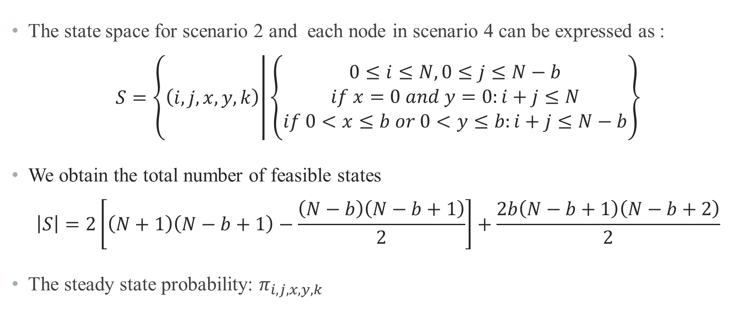
Analytical Model
The state space for scenario 2 and each node in scenario 4 can be expressed as :
$$S=\left\{\left(i,j, x,y, k\right) | \left\{\begin{aligned}0≤i≤N, 0≤j≤N−b \\ if x=0 and y=0:i+j≤N \\ if 0<x≤b or 0<y≤b:i+j≤N−b\end{aligned}\right.\right\}$$
We obtain the total number of feasible states
$$\left|S\right|=2\left[\left(N+1\right)\left(N−b+1\right)−\frac{\left(N−b\right)\left(N−b+1\right)}{2}\right]+\frac{2b\left(N−b+1\right)\left(N−b+2\right)}{2}$$
The steady state probability: $π_{i,j,x,y,k}$

Slide 21
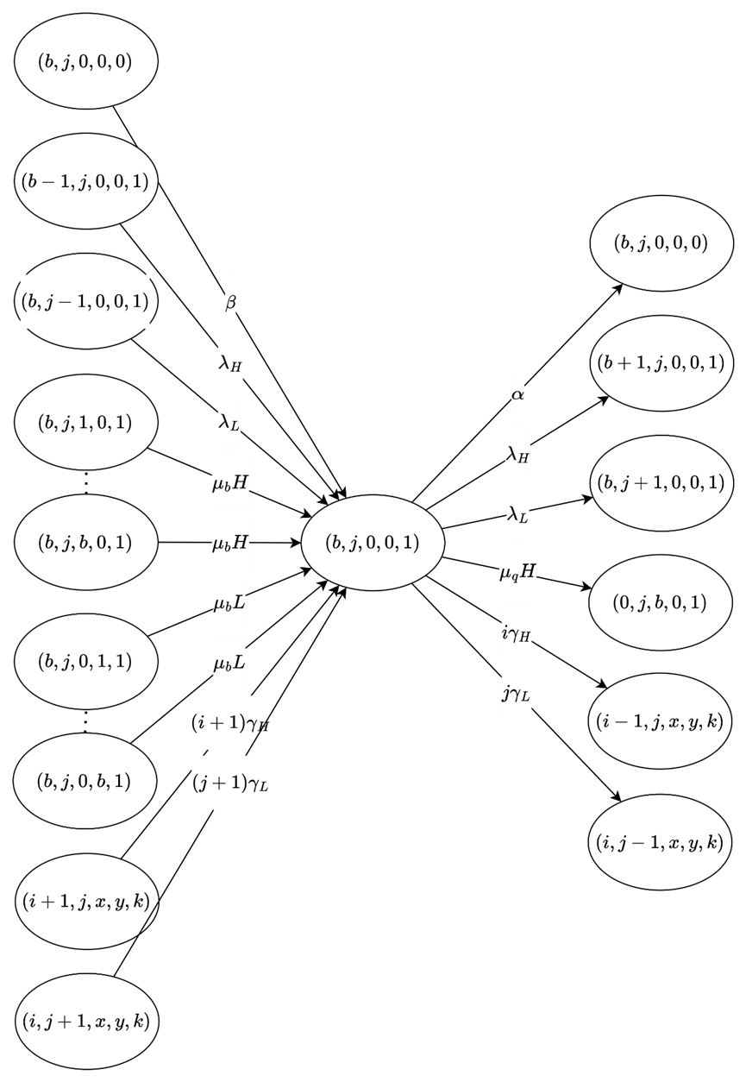
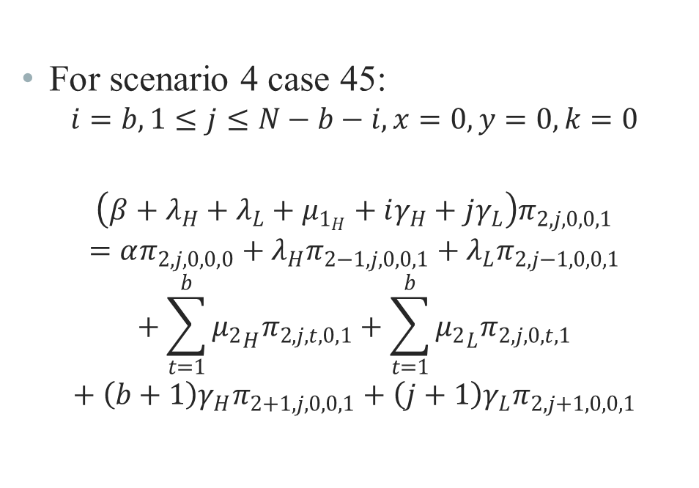
Analytical Model – State Balance Equations
For scenario 4 case 45:
$$i=b,1≤j≤N−b−i,x=0,y=0,k=0$$
$$\left(β+λ_{H}+λ_{L}+μ_{1_{H}}+iγ_{H}+jγ_{L}\right)π_{2,j,0,0,1}=απ_{2,j,0,0,0}+λ_{H}π_{2−1,j,0,0,1}+λ_{L}π_{2,j−1,0,0,1}+\sum_{t=1}^{b}{{μ_{2}}_{H}π_{2,j,t,0,1}}+\sum_{t=1}^{b}{{μ_{2}}_{L}π_{2,j,0,t,1}}+\left(b+1\right)γ_{H}π_{2+1,j,0,0,1}+\left(j+1\right)γ_{L}π_{2,j+1,0,0,1}$$

Slide 22
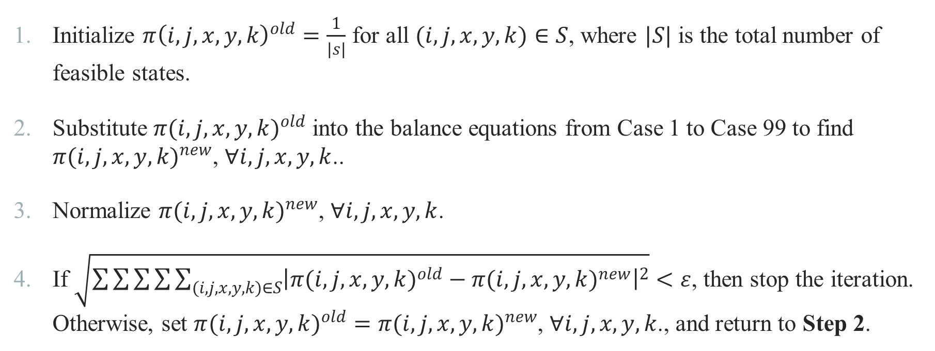
Analytical Model – Iterative Algorism
Initialize $π{\left(i,j,x,y,k\right)}^{old}=\frac{1}{\left|s\right|}$ for all $(i,j,x,y,k)∈S$, where $|S|$ is the total number of feasible states.
Substitute ${π(i,j,x,y,k)}^{old}$ into the balance equations from Case 1 to Case 99 to find ${π(i,j,x,y,k)}^{new}$, $∀i,j,x,y,k$..
Normalize ${π(i,j,x,y,k)}^{new}$, $∀i,j,x,y,k$.
If $\sqrt{\sum{\sum{\sum{\sum{\sum_{(i,j,x,y,k)∈S}{{\left|{π(i,j,x,y,k)}^{old}−{π(i,j,x,y,k)}^{new}\right|}^{2}}}}}}}<ε$, then stop the iteration. Otherwise, set ${π(i,j,x,y,k)}^{old}={π(i,j,x,y,k)}^{new}$, $∀i,j,x,y,k$., and return to Step 2.

Slide 23
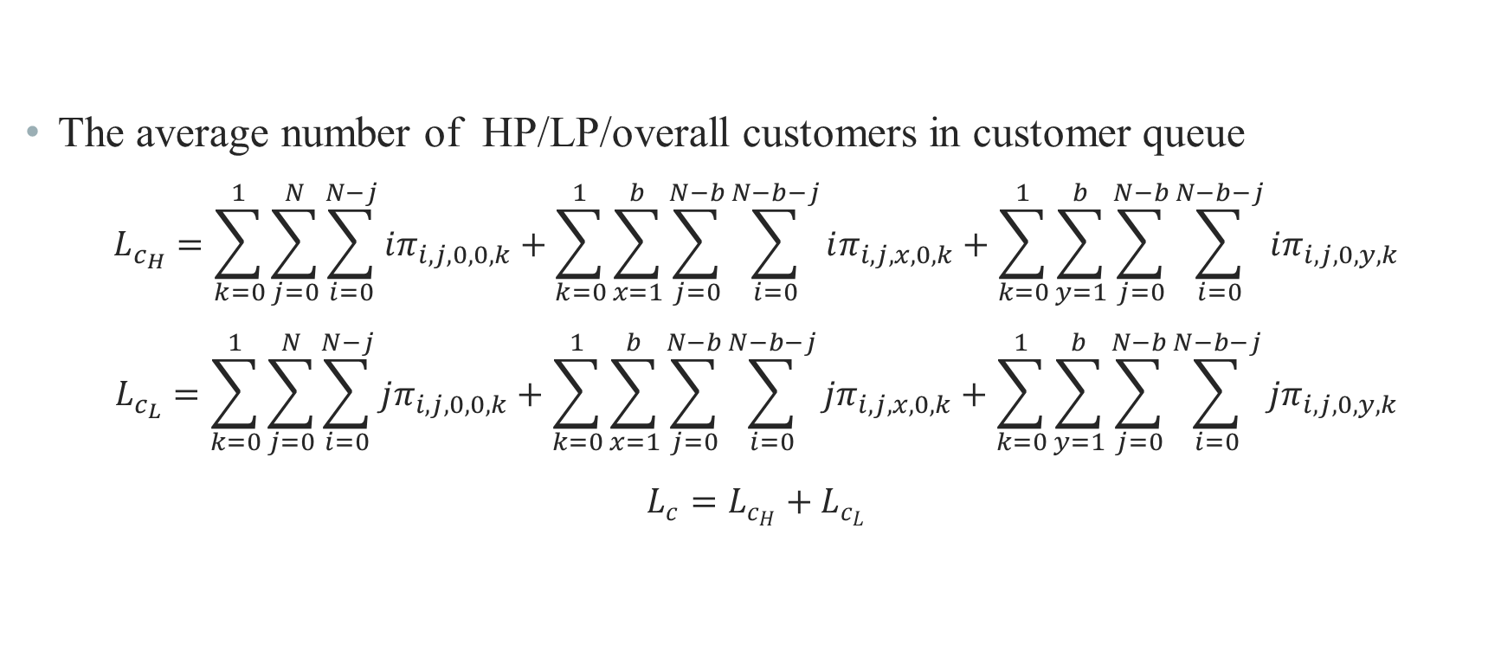
Analytical Model – Performance Measure
The average number of HP/LP/overall customers in customer queue
$$L_{c_{H}}=\sum_{k=0}^{1}{\sum_{j=0}^{N}{\sum_{i=0}^{N−j}{iπ_{i,j,0,0,k}}}}+\sum_{k=0}^{1}{\sum_{x=1}^{b}{\sum_{j=0}^{N−b}{\sum_{i=0}^{N−b−j}{iπ_{i,j,x,0,k}}}}}+\sum_{k=0}^{1}{\sum_{y=1}^{b}{\sum_{j=0}^{N−b}{\sum_{i=0}^{N−b−j}{iπ_{i,j,0,y,k}}}}}$$
$$L_{c_{L}}=\sum_{k=0}^{1}{\sum_{j=0}^{N}{\sum_{i=0}^{N−j}{jπ_{i,j,0,0,k}}}}+\sum_{k=0}^{1}{\sum_{x=1}^{b}{\sum_{j=0}^{N−b}{\sum_{i=0}^{N−b−j}{jπ_{i,j,x,0,k}}}}}+\sum_{k=0}^{1}{\sum_{y=1}^{b}{\sum_{j=0}^{N−b}{\sum_{i=0}^{N−b−j}{jπ_{i,j,0,y,k}}}}}$$
$$L_{c}=L_{c_{H}}+L_{c_{L}}$$

Slide 24
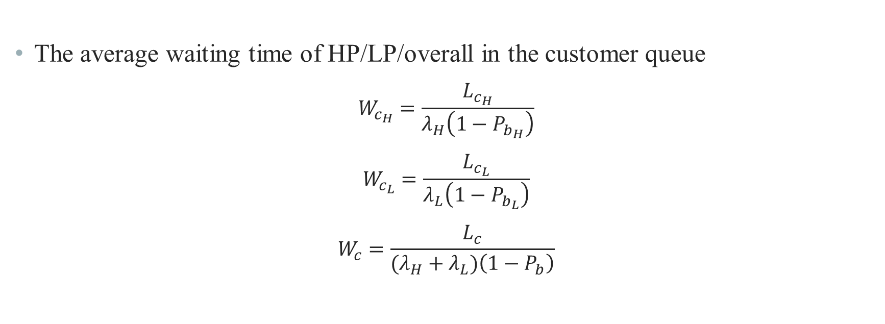
Analytical Model – Performance Measure
The average waiting time of HP/LP/overall in the customer queue
$$W_{c_{H}}=\frac{L_{c_{H}}}{λ_{H}\left(1−P_{b_{H}}\right)}$$
$$W_{c_{L}}=\frac{L_{c_{L}}}{λ_{L}\left(1−P_{b_{L}}\right)}$$
$$W_{c}=\frac{L_{c}}{(λ_{H}+λ_{L})\left(1−P_{b}\right)}$$

Slide 25
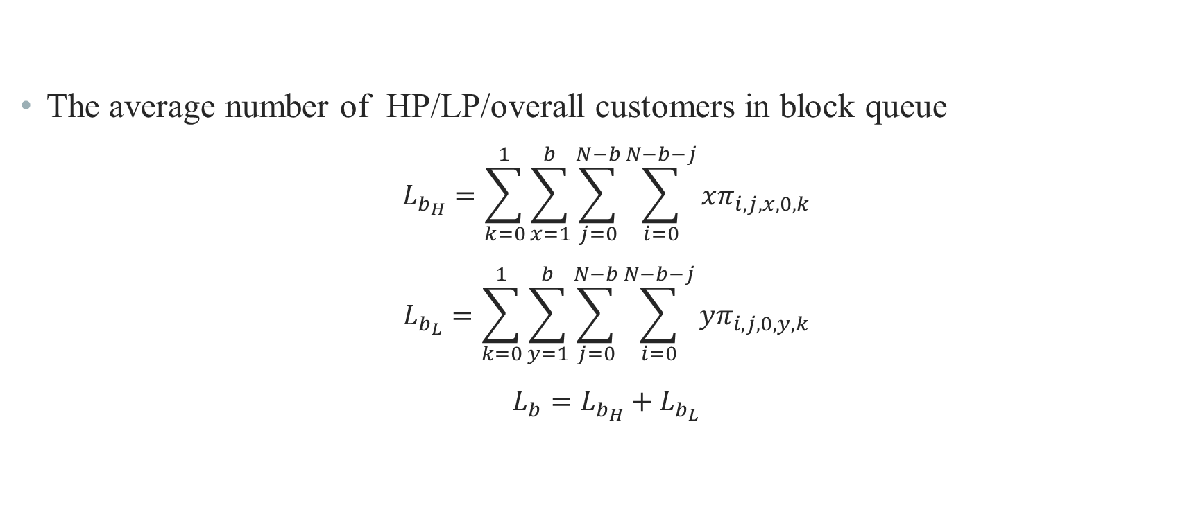
Analytical Model – Performance Measure
The average number of HP/LP/overall customers in block queue
$$L_{b_{H}}=\sum_{k=0}^{1}{\sum_{x=1}^{b}{\sum_{j=0}^{N−b}{\sum_{i=0}^{N−b−j}{xπ_{i,j,x,0,k}}}}}$$
$$L_{b_{L}}=\sum_{k=0}^{1}{\sum_{y=1}^{b}{\sum_{j=0}^{N−b}{\sum_{i=0}^{N−b−j}{yπ_{i,j,0,y,k}}}}}$$
$$L_{b}=L_{b_{H}}+L_{b_{L}}$$

Slide 26
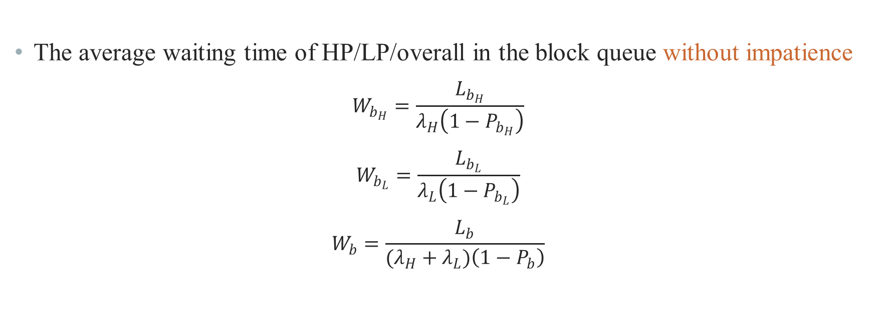
Analytical Model – Performance Measure
The average waiting time of HP/LP/overall in the block queue without impatience
$$W_{b_{H}}=\frac{L_{b_{H}}}{λ_{H}\left(1−P_{b_{H}}\right)}$$
$$W_{b_{L}}=\frac{L_{b_{L}}}{λ_{L}\left(1−P_{b_{L}}\right)}$$
$$W_{b}=\frac{L_{b}}{(λ_{H}+λ_{L})\left(1−P_{b}\right)}$$

Slide 27
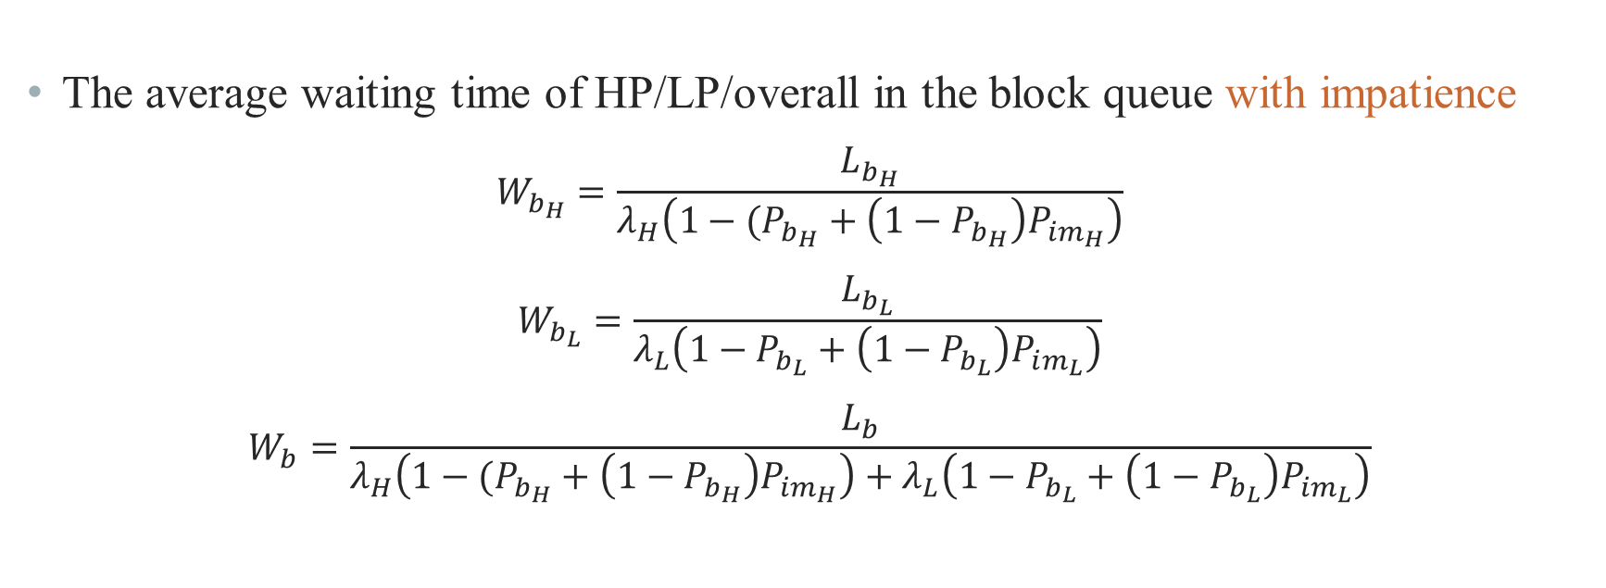
Analytical Model – Performance Measure
The average waiting time of HP/LP/overall in the block queue with impatience
$$W_{b_{H}}=\frac{L_{b_{H}}}{λ_{H}\left(1−(P_{b_{H}}+\left(1−P_{b_{H}}\right)P_{im_{H}}\right)}$$
$$W_{b_{L}}=\frac{L_{b_{L}}}{λ_{L}\left(1−P_{b_{L}}+\left(1−P_{b_{L}}\right)P_{im_{L}}\right)}$$
$$W_{b}=\frac{L_{b}}{λ_{H}\left(1−(P_{b_{H}}+\left(1−P_{b_{H}}\right)P_{im_{H}}\right)+λ_{L}\left(1−P_{b_{L}}+\left(1−P_{b_{L}}\right)P_{im_{L}}\right)}$$

Slide 28
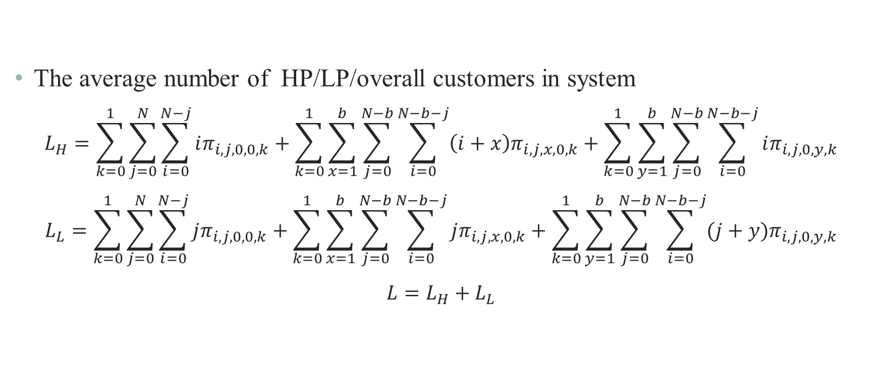
Analytical Model – Performance Measure
The average number of HP/LP/overall customers in system
$$L_{H}=\sum_{k=0}^{1}{\sum_{j=0}^{N}{\sum_{i=0}^{N−j}{iπ_{i,j,0,0,k}}}}+\sum_{k=0}^{1}{\sum_{x=1}^{b}{\sum_{j=0}^{N−b}{\sum_{i=0}^{N−b−j}{\left(i+x\right)π_{i,j,x,0,k}}}}}+\sum_{k=0}^{1}{\sum_{y=1}^{b}{\sum_{j=0}^{N−b}{\sum_{i=0}^{N−b−j}{iπ_{i,j,0,y,k}}}}}$$
$$L_{L}=\sum_{k=0}^{1}{\sum_{j=0}^{N}{\sum_{i=0}^{N−j}{jπ_{i,j,0,0,k}}}}+\sum_{k=0}^{1}{\sum_{x=1}^{b}{\sum_{j=0}^{N−b}{\sum_{i=0}^{N−b−j}{jπ_{i,j,x,0,k}}}}}+\sum_{k=0}^{1}{\sum_{y=1}^{b}{\sum_{j=0}^{N−b}{\sum_{i=0}^{N−b−j}{(j+y)π_{i,j,0,y,k}}}}}$$
$$L=L_{H}+L_{L}$$

Slide 29
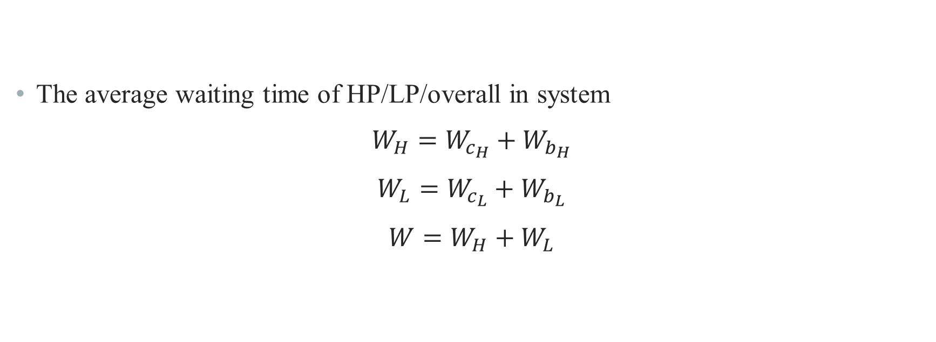
Analytical Model – Performance Measure
The average waiting time of HP/LP/overall in system
$$W_{H}=W_{c_{H}}+W_{b_{H}}$$
$$W_{L}=W_{c_{L}}+W_{b_{L}}$$
$$W=W_{H}+W_{L}$$

Slide 30
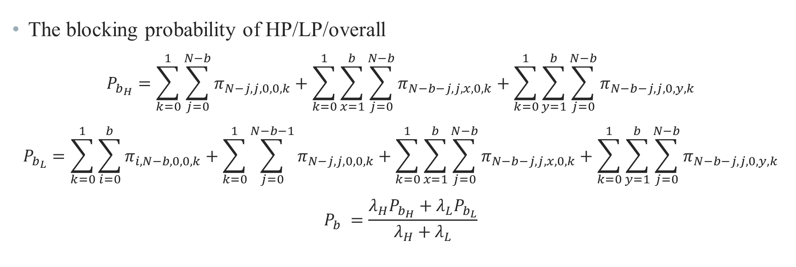
Analytical Model – Performance Measure
The blocking probability of HP/LP/overall
$$P_{b_{H}}=\sum_{k=0}^{1}{\sum_{j=0}^{N−b}{π_{N−j,j,0,0,k}}}+\sum_{k=0}^{1}{\sum_{x=1}^{b}{\sum_{j=0}^{N−b}{π_{N−b−j,j,x,0,k}}}}+\sum_{k=0}^{1}{\sum_{y=1}^{b}{\sum_{j=0}^{N−b}{π_{N−b−j,j,0,y,k}}}}$$
$$P_{b_{L}}=\sum_{k=0}^{1}{\sum_{i=0}^{b}{π_{i,N−b,0,0,k}}}+\sum_{k=0}^{1}{\sum_{j=0}^{N−b−1}{π_{N−j,j,0,0,k}}}+\sum_{k=0}^{1}{\sum_{x=1}^{b}{\sum_{j=0}^{N−b}{π_{N−b−j,j,x,0,k}}}}+\sum_{k=0}^{1}{\sum_{y=1}^{b}{\sum_{j=0}^{N−b}{π_{N−b−j,j,0,y,k}}}}$$
$$P_{b} =\frac{λ_{H}P_{b_{H}}+λ_{L}P_{b_{L}}}{λ_{H}+λ_{L}}$$

Slide 31
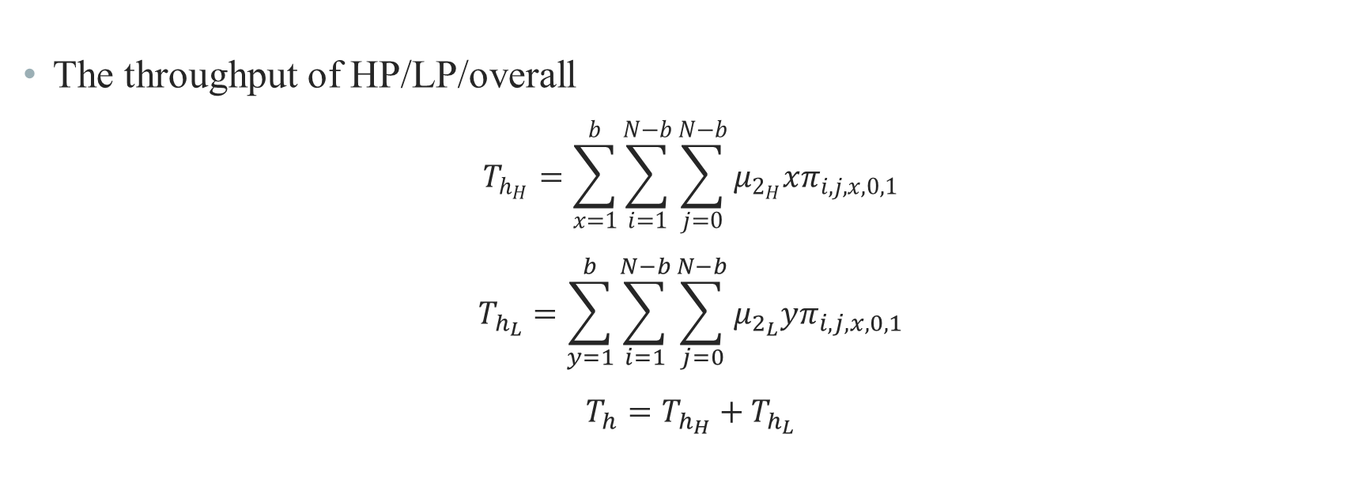
Analytical Model – Performance Measure
The throughput of HP/LP/overall
$$T_{h_{H}}=\sum_{x=1}^{b}{\sum_{i=1}^{N−b}{\sum_{j=0}^{N−b}{μ_{2_{H}}xπ_{i,j,x,0,1}}}}$$
$$T_{h_{L}}=\sum_{y=1}^{b}{\sum_{i=1}^{N−b}{\sum_{j=0}^{N−b}{μ_{2_{L}}yπ_{i,j,x,0,1}}}}$$
$$T_{h}=T_{h_{H}}+T_{h_{L}}$$

Slide 32
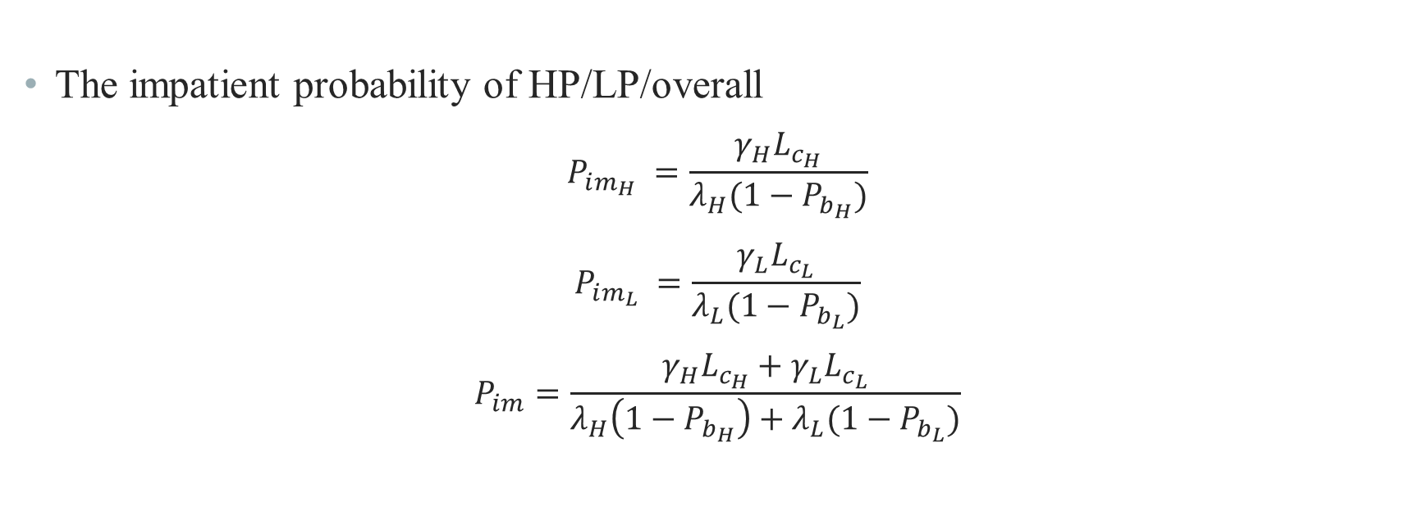
Analytical Model – Performance Measure
The impatient probability of HP/LP/overall
$$P_{im_{H}} =\frac{γ_{H}L_{c_{H}}}{λ_{H}(1−P_{b_{H}})}$$
$$P_{im_{L}} =\frac{γ_{L}L_{c_{L}}}{λ_{L}(1−P_{b_{L}})}$$
$$P_{im}=\frac{{γ_{H}L_{c_{H}}+γ}_{L}L_{c_{L}}}{λ_{H}\left(1−P_{b_{H}}\right)+λ_{L}(1−P_{b_{L}})}$$

Slide 33
Outline
Motivation
System Model
Analytical Model
Numerical Results
Conclusions and Future Works

Slide 34
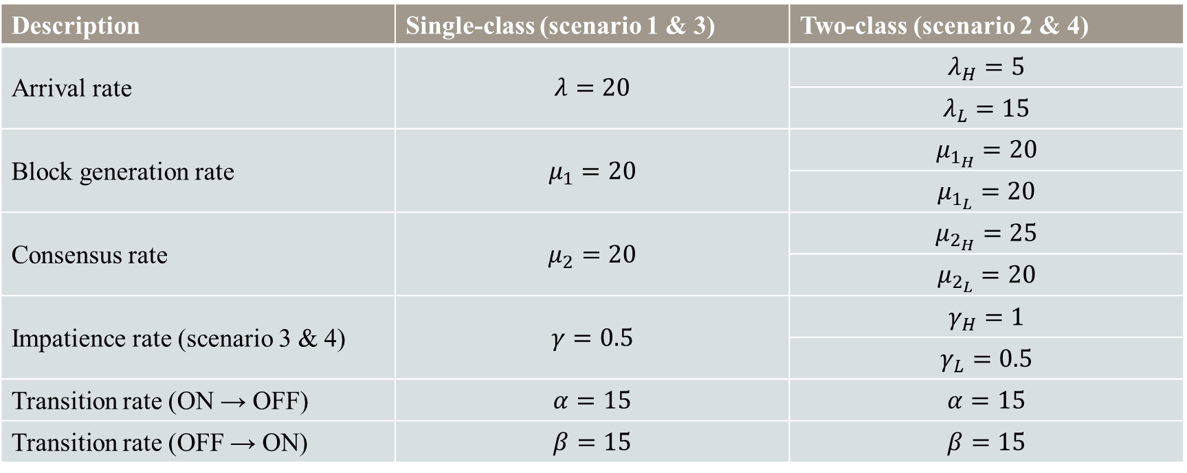
Numerical Result
Description | Single-class (scenario 1 & 3) | Two-class (scenario 2 & 4)
Arrival rate | $$λ=20$$ | $$λ_{H}=5$$
 |  | $$λ_{L}=15$$
Block generation rate | $$μ_{1}=20$$ | $$μ_{1_{H}}=20$$
 |  | $$μ_{1_{L}}=20$$
Consensus rate | $$μ_{2}=20$$ | $$μ_{2_{H}}=25$$
 |  | $$μ_{2_{L}}=20$$
Impatience rate (scenario 3 & 4) | $$γ=0.5$$ | $$γ_{H}=1$$
 |  | $$γ_{L}=0.5$$
Transition rate (ON → OFF) | $$α=15$$ | $$α=15$$
Transition rate (OFF → ON) | $$β=15$$ | $$β=15$$
$N=20$, $b=5$ for all scenarios

Slide 35
Numerical Result – scenario 1 vs 3

Slide 36
Numerical Result – scenario 1 vs 3

Slide 37
Numerical Result – scenario 1 vs 3

Slide 38
Numerical Result – scenario 2 vs 4

Slide 39
Numerical Result – scenario 2 vs 4

Slide 40
Numerical Result – scenario 2 vs 4

Slide 41
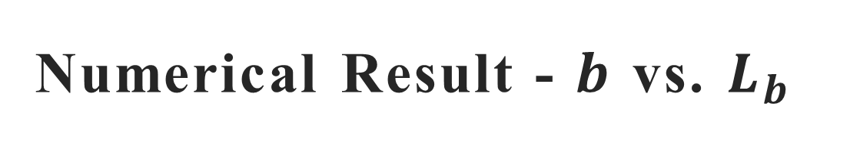
Numerical Result - $b$ vs. $L_{b}$

Slide 42
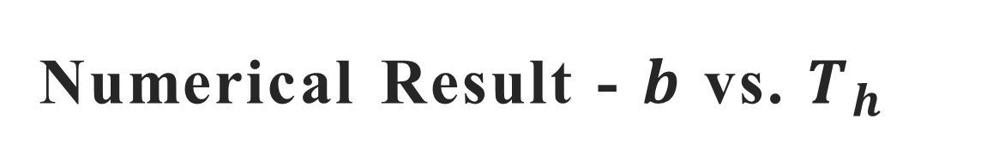
Numerical Result - $b$ vs. $T_{h}$

Slide 43
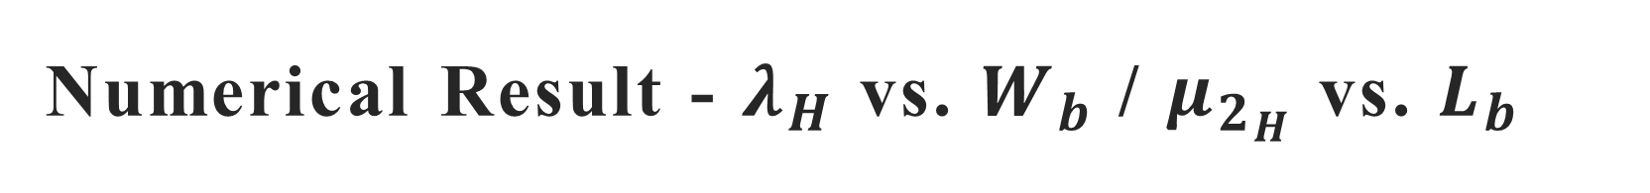
Numerical Result - $λ_{H}$ vs. $W_{b}$ / $μ_{2_{H}}$ vs. $L_{b}$

Slide 44
Outline
Motivation
System Model
Analytical Model
Numerical Results
Conclusions and Future Works

Slide 45
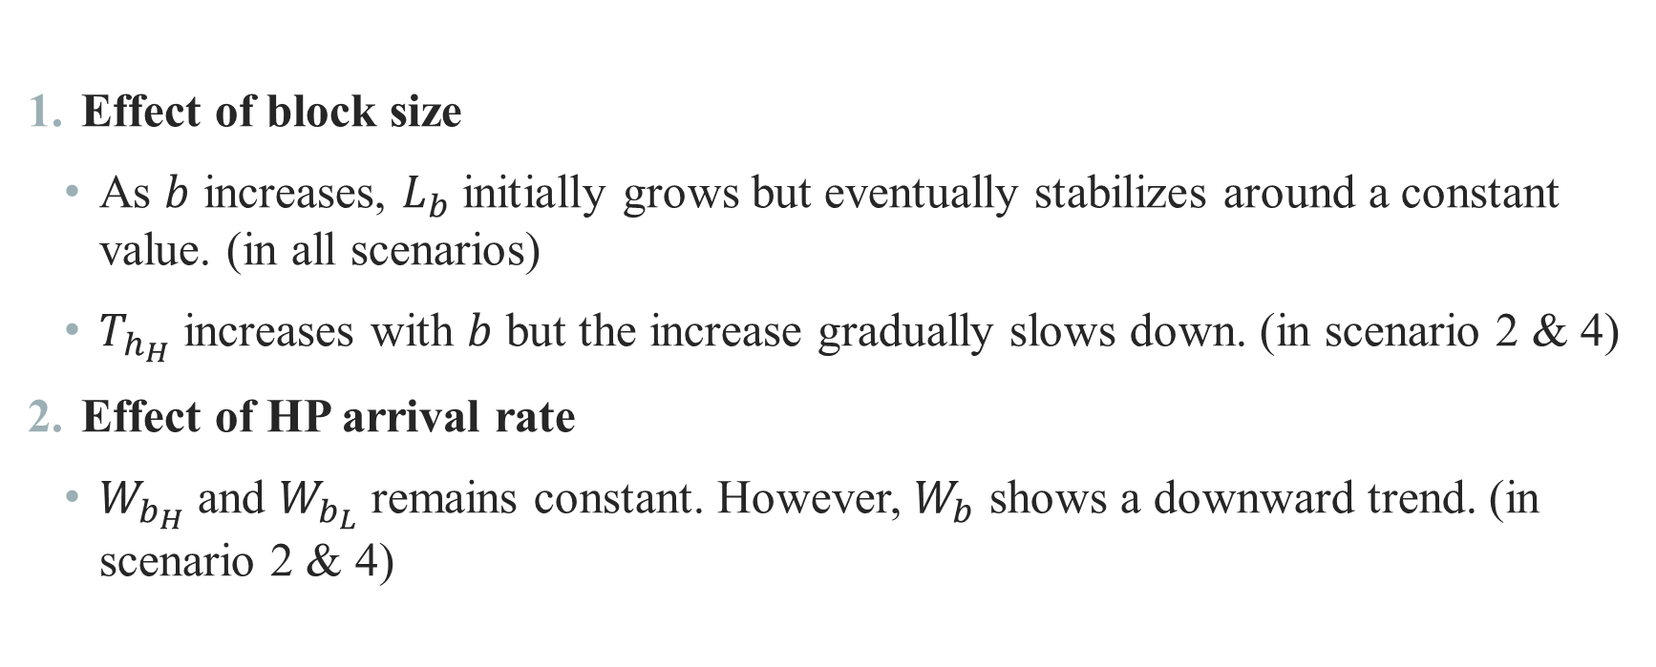
Conclusion
Effect of block size
As $b$ increases, $L_{b}$ initially grows but eventually stabilizes around a constant value. (in all scenarios)
$T_{h_{H}}$ increases with $b$ but the increase gradually slows down. (in scenario 2 & 4)
Effect of HP arrival rate
$W_{b_{H}}$ and $W_{b_{L}}$ remains constant. However, $W_{b}$ shows a downward trend. (in scenario 2 & 4)

Slide 46
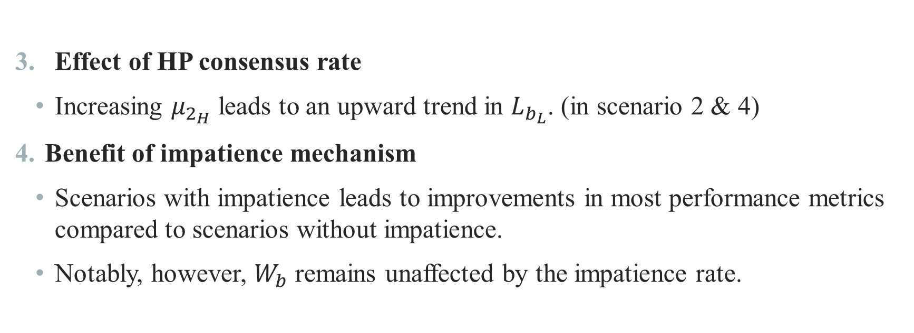
Conclusion
Effect of HP consensus rate
Increasing $μ_{2_{H}}$ leads to an upward trend in $L_{b_{L}}$. (in scenario 2 & 4)
Benefit of impatience mechanism
Scenarios with impatience leads to improvements in most performance metrics compared to scenarios without impatience.
Notably, however, $W_{b}$ remains unaffected by the impatience rate.

Slide 47
Future Work
Incorporate realistic voting mechanisms
Integrate more practical consensus voting procedures to reflect actual blockchain operations.
Dynamic batch policy optimization
Adapt the batch size based on the real-time state of the customer and block queues.
Enhanced impatience modeling
Extend impatience behavior to account for total time until departure, including both waiting and consensus delays.

Slide 48
Thank you for listening

